Slide 1


Optimizing UIs using
Constraint Layout
Google I/O Extended Yangon
8th July 2018
Photo by Dmitri Popov on Unsplash

Slide 2


Lin Min Phyo
Android Developer @ nexlabs

Slide 3
Constraint Layout
ViewGroup which children views have abilities to add constraints

Slide 4
What are constraints ?
Connections between views
Connections between view and parent viewgroup
Helpers that allowed connections

Slide 5
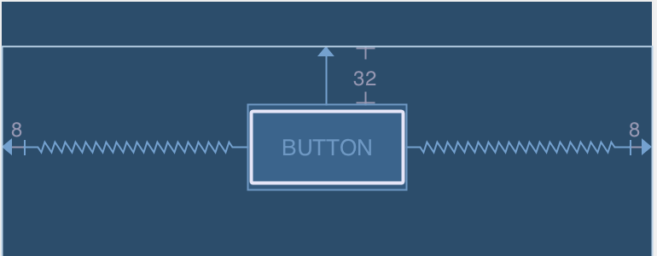
Constraints in Constraint layout

Slide 6
Constraint Layout
=
All about of connections between views

Slide 7
Why Constraint layout?
Easier dimensions and positioning
Minimize nested view groups
Groups, guidelines, placeholders
Auto transitions using Constraint Sets

Slide 8
Constraint Layout
Positioning

Slide 9
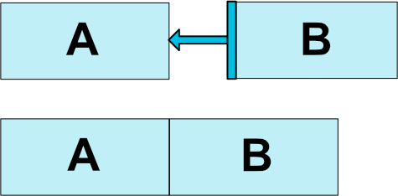
Constraint Layout
Positioning Attributes
<Button android:id="@+id/buttonA" ... />
<Button android:id="@+id/buttonB" ... app:layout_constraintStart_toEndOf="@+id/buttonA" />

Slide 10
Constraint Layout
Positioning Attributes
<Button
android:id="@+id/buttonB" ...
app:layout_constraint _to Of="@+id/buttonA"
/>
buttonB’s side
(top,bottom,start,end)
buttonA’s side
(top,bottom,start,end)

Slide 11
Constraint Layout
Positioning Attributes
A
B
<Button
android:id="@+id/buttonB" ...
app:layout_constraintTop_toBottomOf="@+id/buttonA"
/>

Slide 12
Constraint Layout
Positioning Attributes
A
B
<Button
android:id="@+id/buttonB" ...
app:layout_constraintStart_toStartOf="@+id/buttonA"
/>

Slide 13
Constraint Layout
Positioning Attributes
B
<Button
android:id="@+id/buttonB" ...
app:layout_constraintStart_toStartOf="parent"
/>

Slide 14
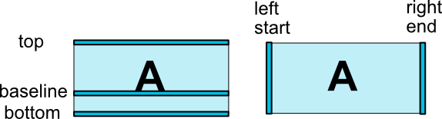
Constraint Layout
Positioning Attributes

Slide 15
Constraint Layout
Positioning Attributes
layout_constraintLeft_toLeftOf | layout_constraintBottom_toTopOf
layout_constraintLeft_toRightOf | layout_constraintBottom_toBottomOf
layout_constraintRight_toLeftOf | layout_constraintStart_toEndOf
layout_constraintRight_toRightOf | layout_constraintStart_toStartOf
layout_constraintTop_toTopOf | layout_constraintEnd_toStartOf
layout_constraintTop_toBottomOf | layout_constraintEnd_toEndOf
layout_constraintBaseline_toBaselineOf

Slide 16
Constraint Layout
Positioning Attributes
Things to note
One vertical constraint and one horizontal constraint should be added
If not, Top left is default
Only 1 constraint for each side
No match parent (use 0 dp instead)
Code sample

Slide 17
Constraint Layout
Bias
Determining which side to bias

Slide 18
Constraint Layout
Bias Attributes
B
30%

Slide 19
Constraint Layout
Bias Attributes
<TextView android:layout_width="wrap_content" android:layout_height="wrap_content" app:layout_constraintEnd_toEndOf="parent" app:layout_constraintStart_toStartOf="parent" app:layout_constraintHorizontal_bias="0.3" />

Slide 20
Constraint Layout
Bias Attributes
Vertical Bias
Horizontal bias
Mixing vertical and horizontal
Code Sample

Slide 21
Constraint Layout
Circular Positioning
Position with angle

Slide 22
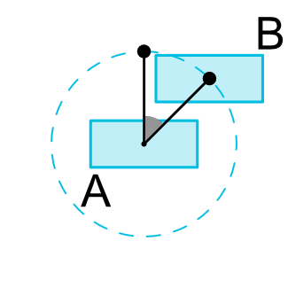
Constraint Layout
Circular Positioning
<Button android:id="@+id/buttonA" ... /> <Button android:id="@+id/buttonB" ... app:layout_constraintCircle="@+id/buttonA" app:layout_constraintCircleRadius="100dp" app:layout_constraintCircleAngle="45" />

Slide 23
Constraint Layout
Group
Grouping views using id

Slide 24
Constraint Layout
Group
<android.support.constraint.Group android:id="@+id/group" android:layout_width="wrap_content" android:layout_height="wrap_content" android:visibility="visible" // gone,invisible app:constraint_referenced_ids="button4,button9" />

Slide 25

Constraint Layout
Circular Positioning + Group

Slide 26
Constraint Layout
Ratio
Determining ratio of views

Slide 27

Constraint Layout
Ratio Attributes
<ImageView android:layout_width="0dp" android:layout_height="0dp" app:layout_constraintStart_toStartOf="parent" app:layout_constraintEnd_toEndOf="parent" app:layout_constraintDimensionRatio="1:1" />

Slide 28

Constraint Layout
Ratio Attributes
<Button android:layout_width="0dp" android:layout_height="0dp" app:layout_constraintBottom_toBottomOf="parent" app:layout_constraintTop_toTopOf="parent" app:layout_constraintDimensionRatio="16:9" />

Slide 29
Constraint Layout
Ratio Attributes
Code sample

Slide 30
Constraint Layout
Guidelines
Virtual, invisible helper views

Slide 31
Constraint Layout
Guideline
A
B

Slide 32
Constraint Layout
Guideline
<android.support.constraint.Guideline android:layout_width="wrap_content" android:layout_height="wrap_content" android:id="@+id/guideline" app:layout_constraintGuide_begin="100dp" android:orientation="vertical" />
100dp

Slide 33
Constraint Layout
Guideline
<android.support.constraint.Guideline android:layout_width="wrap_content" android:layout_height="wrap_content" android:id="@+id/guideline" app:layout_constraintGuide_end="100dp" android:orientation="vertical" />
100dp

Slide 34
Constraint Layout
Guideline
<android.support.constraint.Guideline android:layout_width="wrap_content" android:layout_height="wrap_content" android:id="@+id/guideline" app:layout_constraintGuide_percent="0.5" android:orientation="vertical" />
50%
50%

Slide 35
Constraint Layout
Guideline
Orientation
Vertical
Horizontal
Use cases
Keylines
Reduce multiple margin on views
Code Sample

Slide 36
Constraint Layout
Chain
Linking multiple views in horizontal or vertical

Slide 37
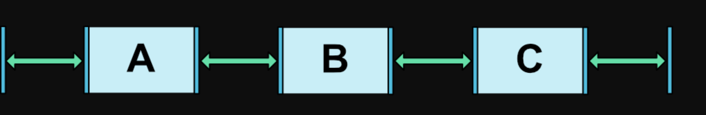
Constraint Layout
Chain
CHAIN_SPREAD

Slide 38
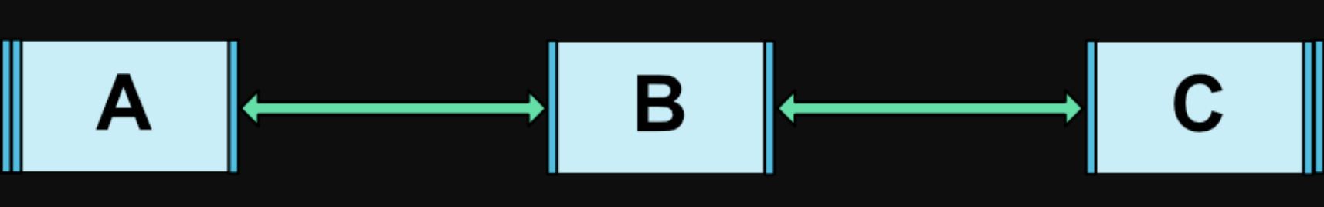
Constraint Layout
Chain
CHAIN_SPREAD_INSIDE

Slide 39
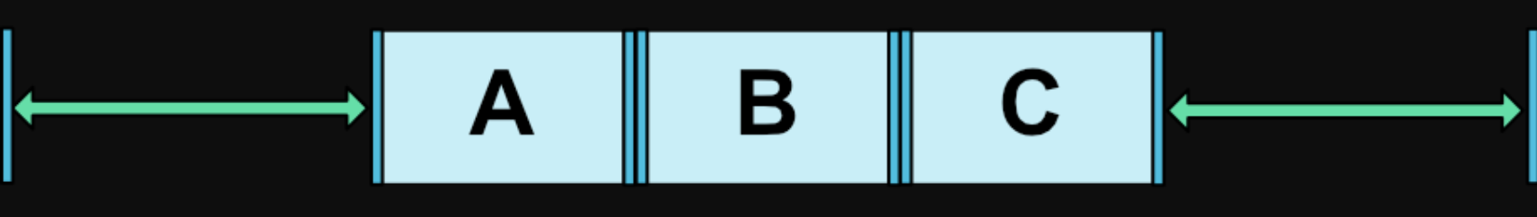
Constraint Layout
Chain
CHAIN_PACKED

Slide 40
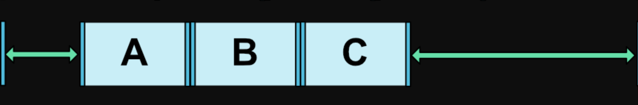
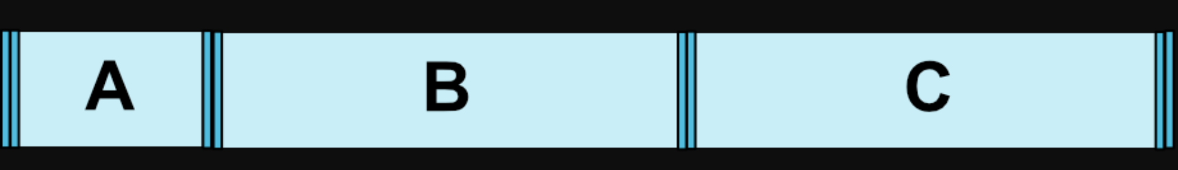
Constraint Layout
Chain
CHAIN_PACKED + Biasing
CHAIN_SPREAD + 0dp (match parent)

Slide 41
Constraint Layout
Chain
Orientation
Vertical
Horizontal
Code Sample

Slide 42
Placeholders
Placeholder view which is ready for other views to place

Slide 43
Constraint Layout
Placeholder
Empty View ( Placeholder ) with constraints
Any view can be swapped into it dynamically or directly in XML
TransitionManager helps auto transitions
PLACEHOLDER

Slide 44
Constraint Layout
Placeholder
Two use cases
Transition by placing dynamically
Template of multi screen support

Slide 45
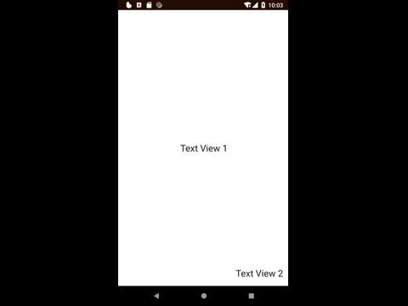
Constraint Layout
Placeholder

Slide 46

Constraint Layout
Placeholder

Slide 47
Constraint Layout
Placeholder
<ImageView android:id="@+id/image" .... /> <android.support.constraint.Placeholder ...... android:id="@+id/placeholder_image" app:content="@+id/image" />

Slide 48
Barriers
Barrier between views

Slide 49
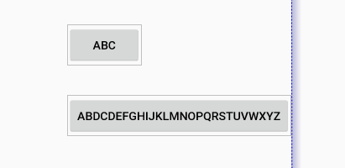
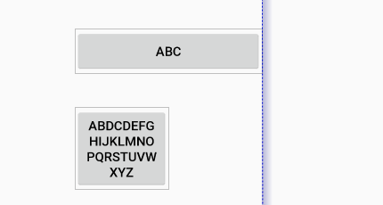
Constraint Layout
Barrier
Want to show a view at the end of two buttons

Slide 50
Constraint Layout
Placeholder
<TextView android:id="@+id/textView1" ... /> <TextView android:id="@+id/textView2" ... /> <android.support.constraint.Barrier android:id="@+id/barrier" app:barrierDirection="right" app:constraint_referenced_ids="textView1, textView2" /> <TextView android:text="Text right of barrier" app:layout_constraintStart_toStartOf="@+id/barrier" />

Slide 51
Constraint Layout
Placeholder
Code Sample

Slide 52
Constraint Sets
Animate between two layouts

Slide 53
Constraint Layout
Constraint Set
Create two layouts
Clone into two ConstraintSets
Apply To ConstraintLayout

Slide 54
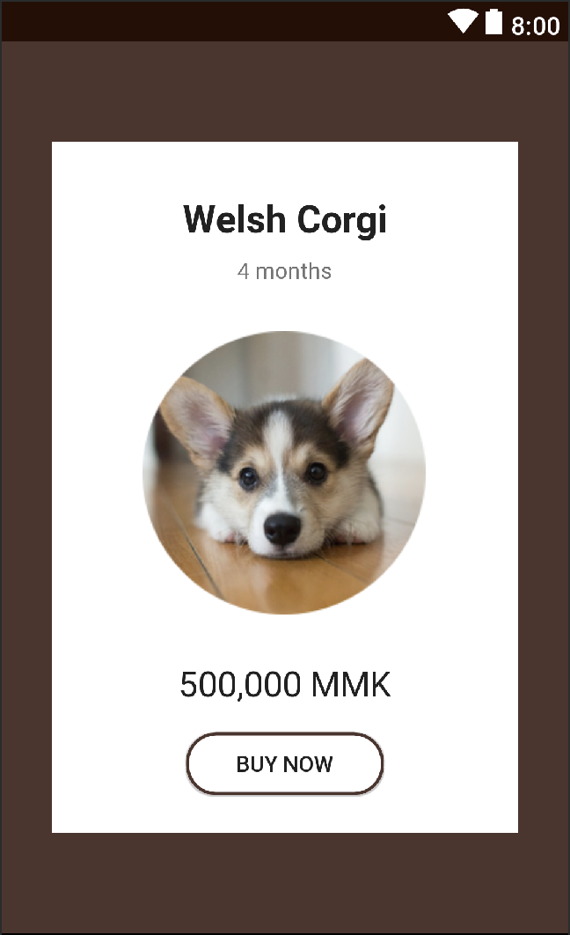
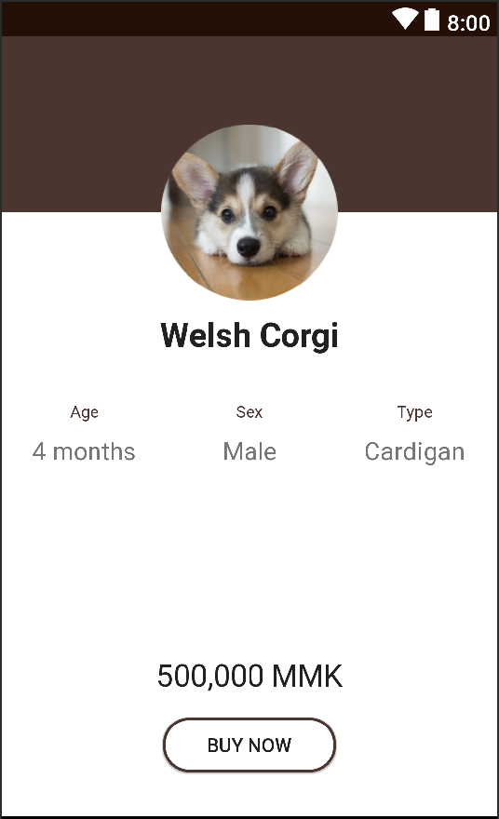
Constraint Layout
Constraint Set

Slide 55
Constraint Layout
Constraint Set
Things to note
Should be inside a single constraint layout
All children must have id
Does not animate text size
Views invisible? Must hide some view on initial layout

Slide 56
Constraint Layout
Do’s
Try Layout Editor
Groups for visibility control
Play with Chains instead of weights
Using Guidelines as keylines
Basic transitions with Constraint sets

Slide 57
Constraint Layout
Don’ts
Do not overuse
Reduce constraints (esp. in Recyclerview)
Think twice before using barriers in Recyclerview
Missing IDs
Nested constraint layout

Slide 58
Constraint Layout 2.0
What’s new

Slide 59
Constraint Layout 2.0
Constraint Helpers
Helper Views like Guidelines
Linear
Flow ( Flexbox style )

Slide 60
Constraint Layout 2,0
Layers
Hide, show, lock elements in editor
Support transforms

Slide 61
Constraint Layout 2.0
Layout Management
Improved layout editor
Constraint sets via xml ( Constraint states )
Motion layout + Motion Scene
( Constraint states + Motion Events + Key Frames )

Slide 62

Constraint Layout 2.0
Motion Layout

Slide 63
Resources
https://constraintlayout.com/
https://developer.android.com/reference/android/support/constraint/ConstraintLayout
https://github.com/hashlin/constraint-layout-example
https://www.youtube.com/watch?v=ytZteMo4ETk
https://medium.com/google-developers/introduction-to-motionlayout-part-i-29208674b10d

Slide 64
Thanks !
Time to start using Constraint Layout

